Slide 1


Franchise Distributor
SUPREME COMPONENTS INTERNATIONAL
Your trusted authorized global distributor of electronic components.
We are obsessed about adding value at the speed of thought.
Established 2001
Date: May 5 2025 Revised_v1.1

Slide 2
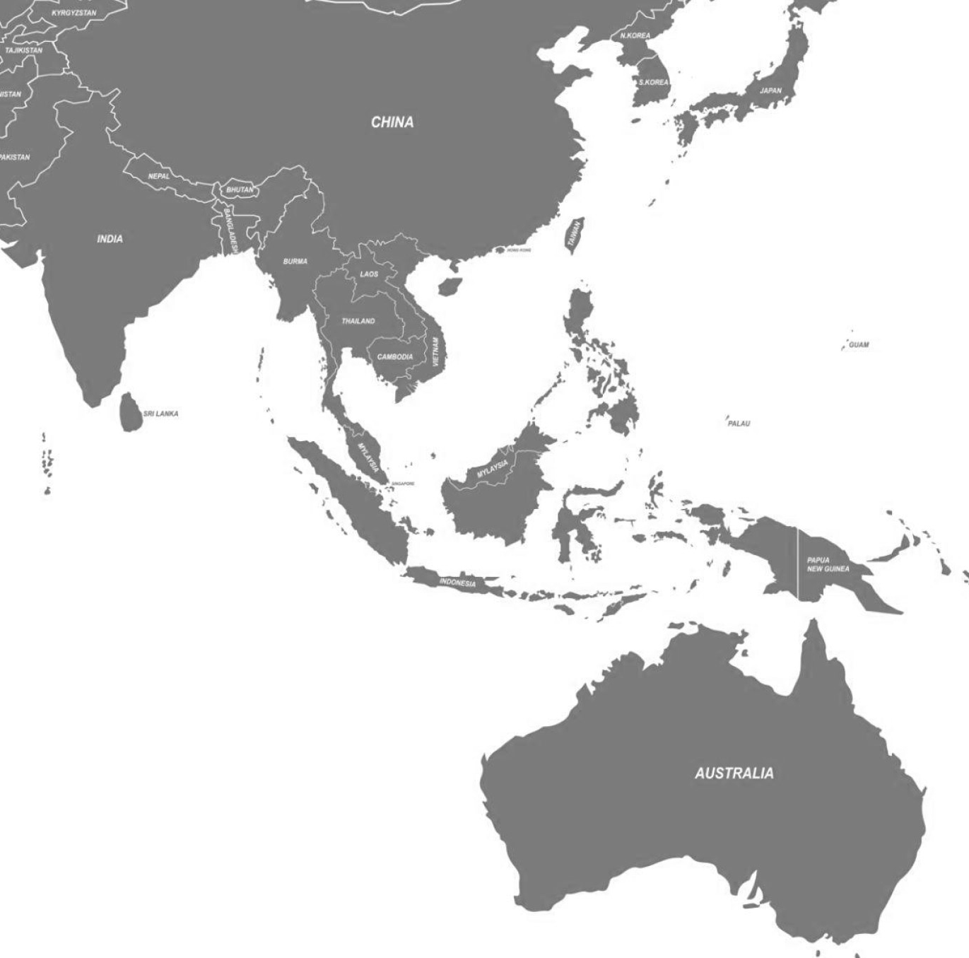





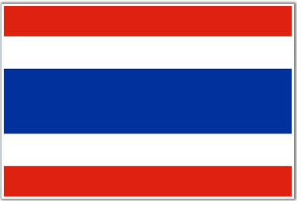



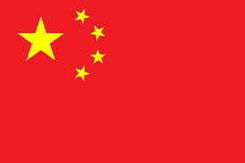
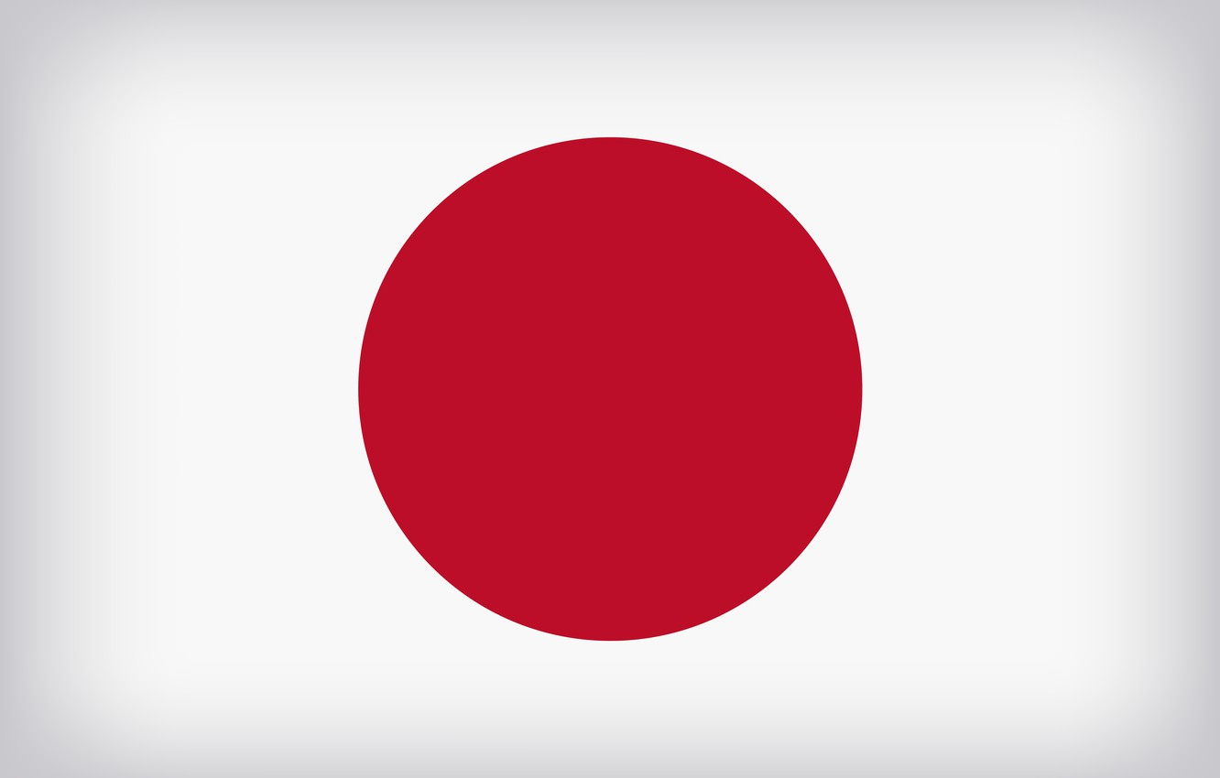
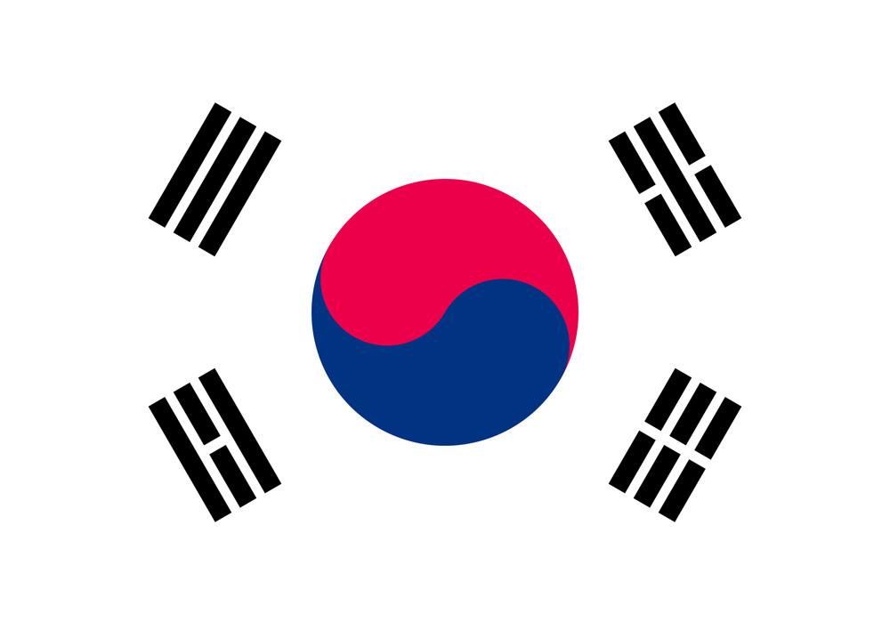


SINCE 2001
Local Billing. Regional Support. Global Execution.
16 Offices
in 12 countries strategically located to streamline your operations globally.
Bucheon
Local billing
To simplify transactions and avoid forex risks with local billing expertise.
Yokohama
New Delhi
Shenzhen
3 Warehouses
In India, Japan, and Singapore to support your local shipping needs
Pune
Hyderabad
Manila
Bangkok
Bangalore
HCM
18 Languages
Spoken to let you communicate in your preferred language across ASEAN and beyond.
KL
Singapore
24 Hours
Support to service the global OEM and EMS clientele
Surabaya
Melbourne
Established: 2001
Headquarters: Singapore
Locations: Singapore, India, Japan, Korea, Thailand, Malaysia, Indonesia, Australia
Employees: 75+
CEO and President: Vick Aggarwala
16 offices strategically located to simplify your supply chain.
Company Confidential

Slide 3
COUNTRIES targeted
SUPREME COMPONENTS INTERNATIONAL (SCI)
INDIA
ASEAN(SINGAPORE, MALAYSIA, VIETNAM, INDONESIA, PHILIPPINES, THAILAND)
AUSTRALIA, NEW ZEALAND
JAPAN
S.KOREA

Slide 4
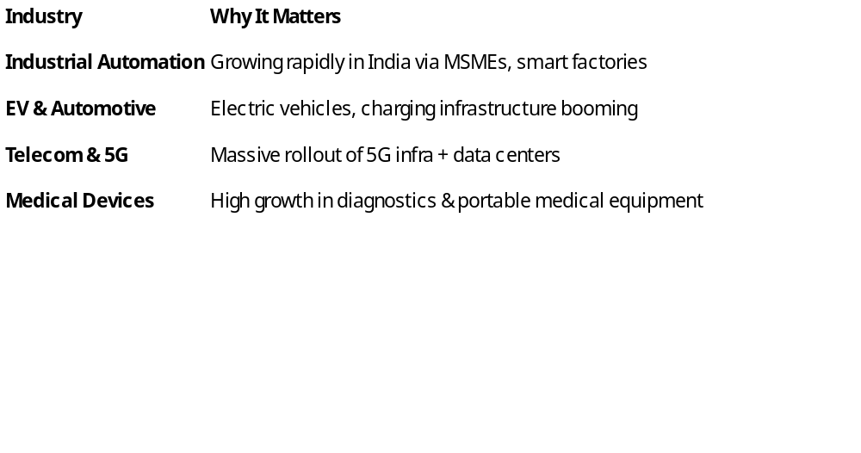
Market focus for India
Business Plan
SUPREME COMPONENTS INTERNATIONAL (SCI)

Slide 5
Target Customers by Segment & Brand
Business Plan
SUPREME COMPONENTS INTERNATIONAL (SCI)
Industrial Automation
Targets:
Siemens
,
Schneider
,
•
ABB,
Honeywell, Rockwell Automation
, Bharat Bijlee
EV / Automotive
Targets:
Tata Elxsi, Ather Energy, Ola Electric, Bosch India, Continental Automotive
Telecom / Networking / Data Centers
Targets:
Tejas Networks, Sterlite Tech, VVDN, HFCL, Tata Communications
Medical Equipment
Targets:
GE Healthcare,
Johari Medical, Trivitron, Skanray, BPL Medical

Slide 6
Target Industries - ASEAN
Business Plan
SUPREME COMPONENTS INTERNATIONAL (SCI)
Industry | Strategic Value
Industrial | Major production hub (Thailand, Vietnam, Malaysia, Philippines)
EV & Transport | Electrification of mobility (Vietnam, Indonesia, Thailand)
Telecom & Data Centers | Strong push for 5G and digital infra (Singapore, Philippines)
Medical Devices | Medical exports and manufacturing (Malaysia, Singapore, Australia)
Defense & Aerospace | Modernization program in Thailand, Indonesia, Malaysia

Slide 7
Business Plan
SUPREME COMPONENTS INTERNATIONAL (SCI)
Industrial
Countries: Thailand, Vietnam, Malaysia, Philippines
Companies: Delta Electronics, Schneider SEA, APC/Schnieder Phil.
EV / Transport
Countries: Thailand, Indonesia, Vietnam
Companies: VinFast

Slide 8
Business Plan
SUPREME COMPONENTS INTERNATIONAL (SCI)
Telecom / Networking/Data Centres
Countries: Singapore, Philippines, Malaysia
Companies: Viettel, ST Engineering
Medical
Countries: Singapore, Malaysia, Australia
Companies: Philips, Medtronic, Abbott, ResMed, Biomed Global
Defense & Aerospace
Countries: Malaysia, Indonesia, Thailand
Companies: ST Engineering, PT Dirgantara, DSO Lab

Slide 9

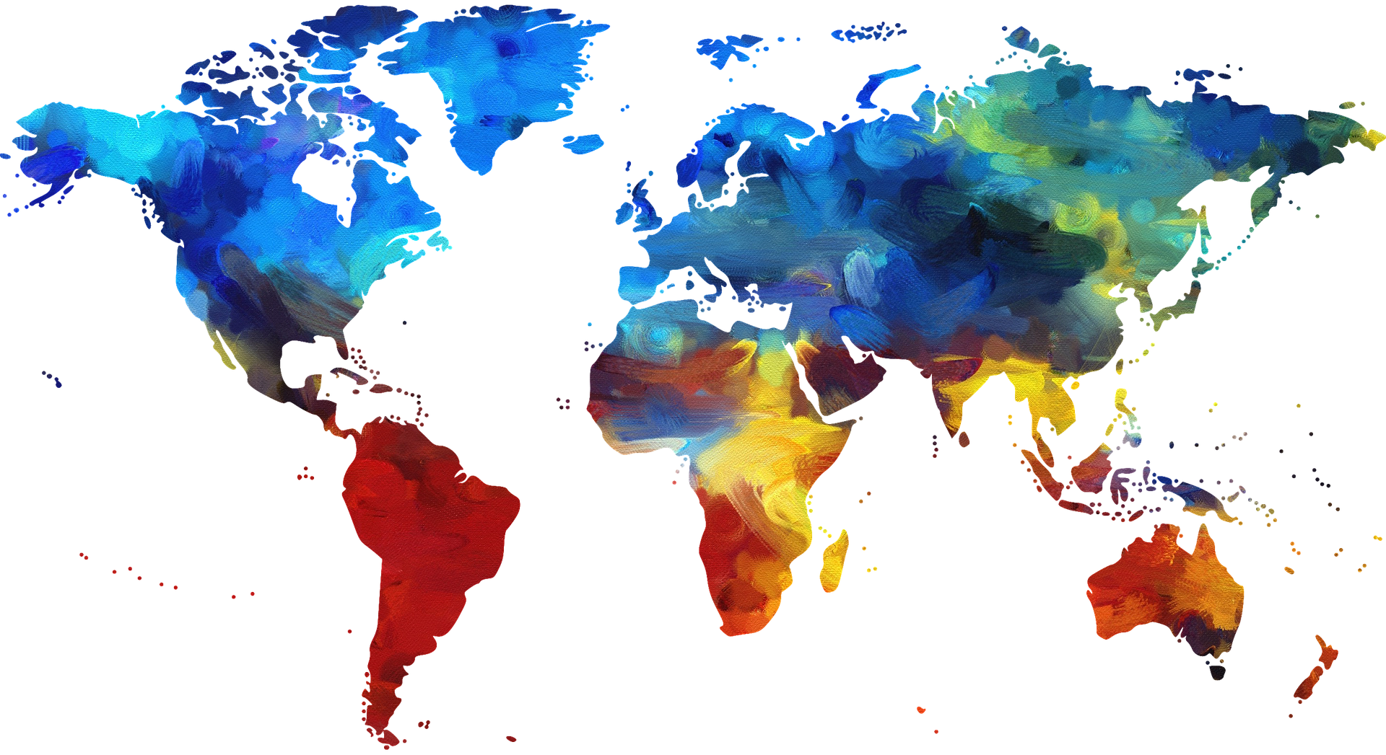





Connect with Us
#ConnectWithUs
(65) 6848 1178
sales@supremecomponents.com
www.supremecomponents.com
62 Jalan Eunos, Singapore 419508

